Slide 1
Chap 3
String Matching

Slide 2
String Matching Problem
A classical and important problem
Searching engines (like Goole and Openfind)
Database (GenBank)

Slide 3
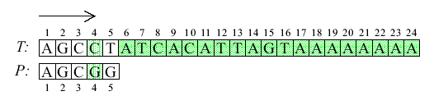

A Brute-Force Algorithm

Slide 4
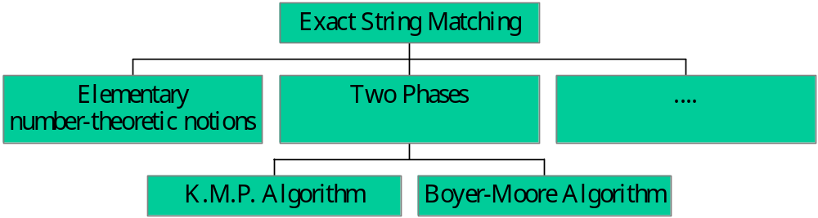
Two Phases
http://www-igm.univ-mlv.fr/~lecroq/string/

Slide 5
Two Phases
Phase 1：generate an array to indicate the moving direction.
Phase 2：make use of the array to move and match string

Slide 6
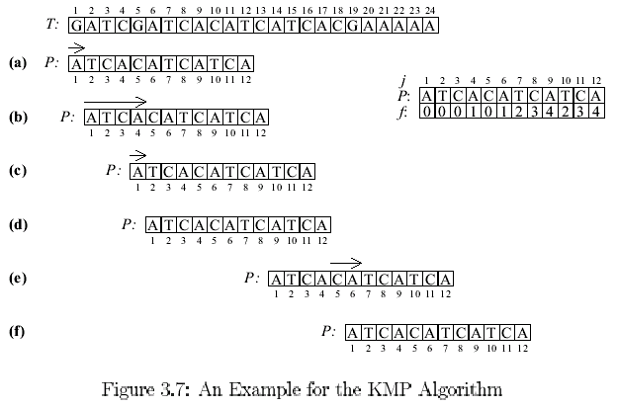
An Example for the K.M.P. Algorithm
Phase 2
Phase 1

Slide 7
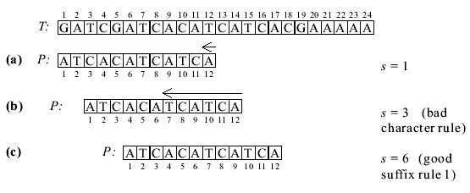
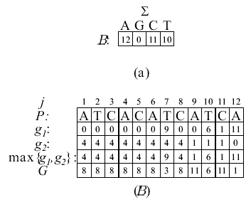
An Example for the Boyer-Moore Algorithm
Phase 2
Phase 1

Slide 8
The K.M.P. Algorithm
Proposed by Knuth, Morris and Pratt in 1977.
Three cases to illustrate their idea.

Slide 9
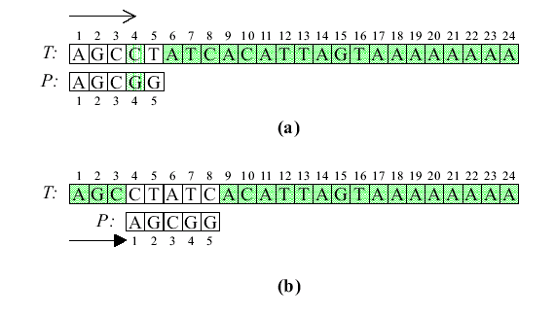
The first Case for the KMP Algorithm

Slide 10
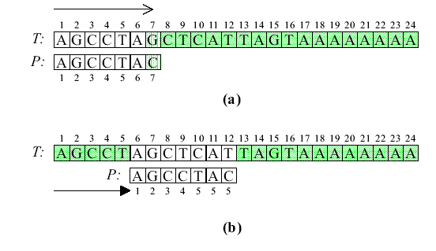
The Second Case for the KMP Algorithm

Slide 11
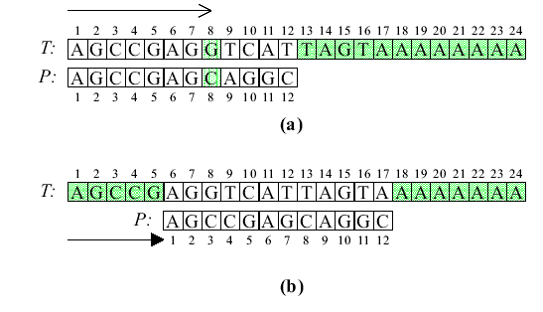
The Third Case for the KMP Algorithm

Slide 12
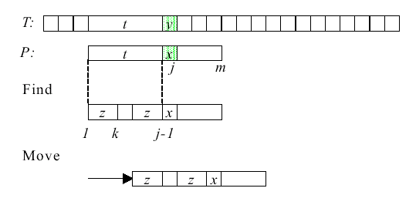
The KMP Alogrithm
a
a

Slide 13

Phase 1：To Compute the Prefix Function
J=k+1 or ?
J-k
j-1
f(j-1)=k
j-1
j
f(j)=f(j-1)+1
f(j-1)
j-1
j
a
f(j)=f(f((j-1))+1
f(j-1)
f(f(j-1))

Slide 14


An Example of the Prefix Function

Slide 15





How to find the Prefix Function(1)
= 1

Slide 16



How to find the Prefix Function(2)

Slide 17



How to find the Prefix Function(3)

Slide 18
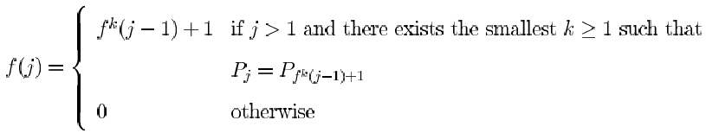
The Prefix Function
j-1
j
k=1 f(j)=f(j-1)+1
f(j-1)
j-1
j
a
k=2 f(j)=f(f((j-1))+1
f(j-1)
f(f(j-1))

Slide 19
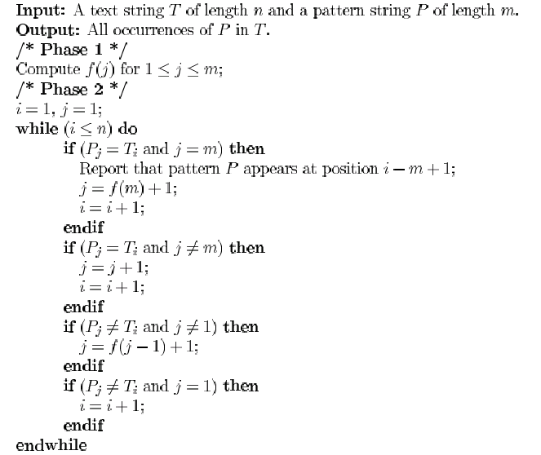
The KMP Algorithm for Exact Matching

Slide 20
An Example for the K.M.P. Algorithm
Phase 2
f(4-1)+1= f(3)+1=0+1=1
Phase 1
f(12)+1= 4+1=5

Slide 21
The analysis of the K.M.P. Algorithm
O(m+n)
  O(m) for computing function f
  O(n) for searching P

Slide 22
An Example for the Boyer-Moore Algorithm
Phase 2
Phase 1

Slide 23
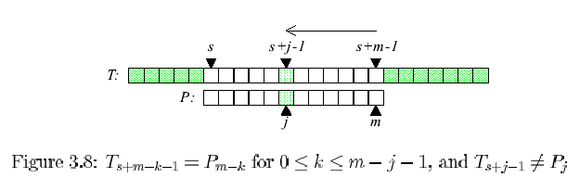
Pairwise-Compareing from Right to Left

Slide 24
The Rule of Moving the Window
Bad Character Rule
Good Suffix Rule
  Good Suffix Rule 1
  Good Suffix Rule 2

Slide 25
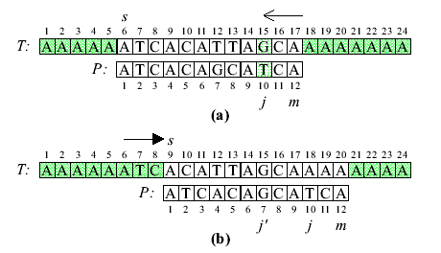
Bad Character Rule (1)

Slide 26
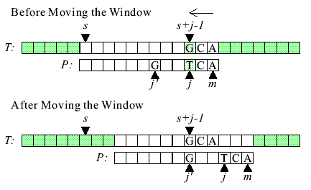
Bad Character Rule (2)

Slide 27
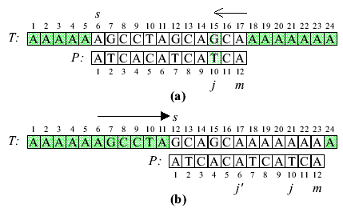
Good Suffix Rule 1(1)

Slide 28
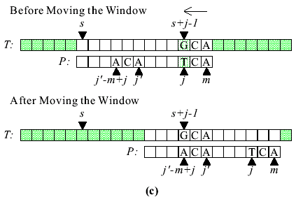
Good Suffix Rule 1(2)

Slide 29
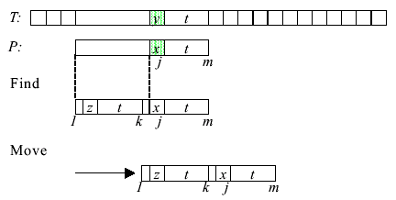
The Movement for Good Suffix Rule 1

Slide 30
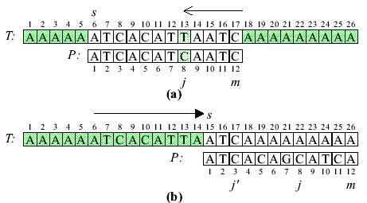
Good Suffix Rule 2(1)

Slide 31
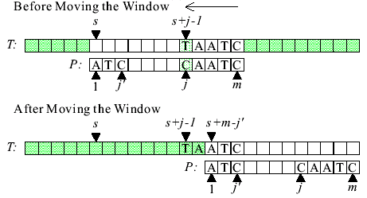
Good Suffix Rule 2(2)

Slide 32
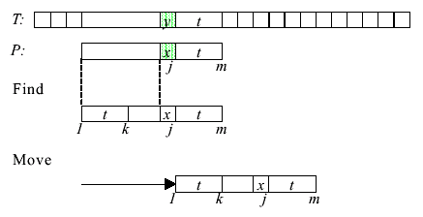
The Movement for Good Suffix Rule 2

Slide 33
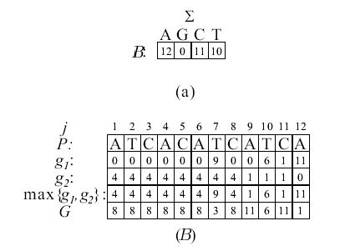

Two Function for the Good Suffix Rule
Function B and G
(b)

Slide 34

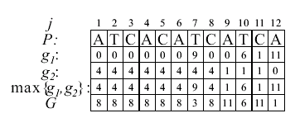

Function g₁(j)
g₁(j)

Slide 35
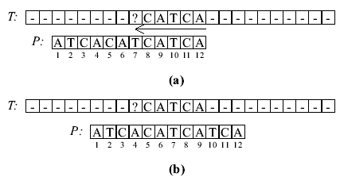
Shifting for the Good Suffix Rule 1 g₁(j)

Slide 36

Functions g₂(j)
g₂(j)

Slide 37
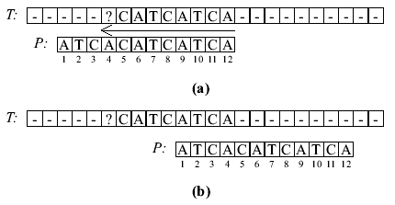
Shifting for the Good Suffix Rule 2 g₂(j)

Slide 38

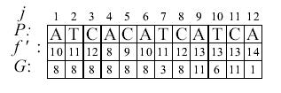
The Suffix Function f’
f’(j) = k or ?
f’(j+1)=k+1
?

Slide 39
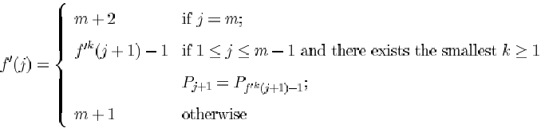
Function f’

Slide 40
Functions f’ and G
Function G can be determined by scanning P twice.
  The first one is a right-to-left scan.
  The second one is a left-to-right scan.
Function f’ is generated in the first right-to-left scan and some values of G can be determined in this scan.

Slide 41
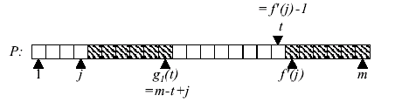
The Computation of g₁(j)
t=f’(j)-1
j
0
0
0
0
0
0
0
0
0
0->3=G(f’(j)-1)=G(7 )=m- g₁( j )=m-( m-t+j )=t-j

Slide 42
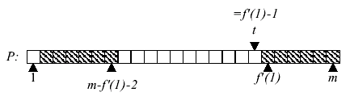
The Computation of g₂(j=1)(1)
j
m-f’(1)+2 ?
t=f’(j)-1
j
0->8=G(j)=m- g₂(j) =m- g₂ (1) =m-( m-f’(1)+2) =f’(1)-2 =10 - 2

Slide 43
The Computation of g₂(j)(2)
j
m-f’(1)+2 ?
t=f’(j)-2
j
0->11=G(j)=m- g₂(j) =m- g₂ (j) =m-( m-f’(j)+1) =f’(j)-1 =12 -1

Slide 44
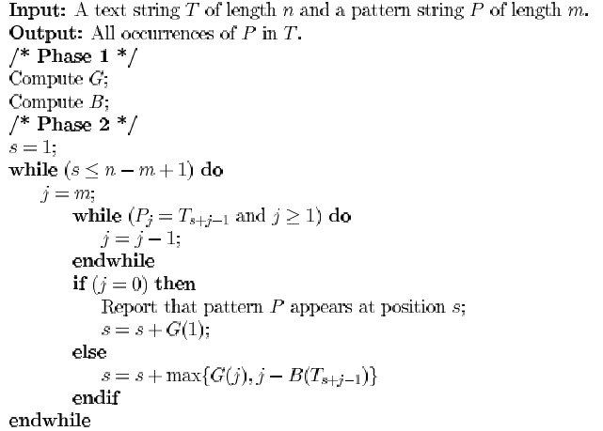
The Boyer-Moore Algorithm for Exact Matching

Slide 45
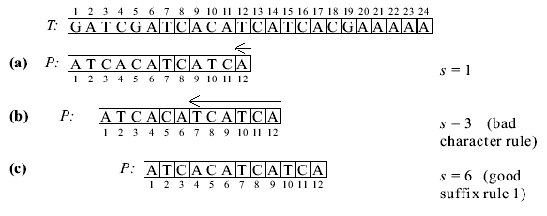
An Example for the Boyer-Moore Algorithm
J=0

Slide 46
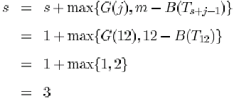
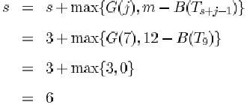
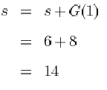
Star Position s

Slide 47
The Analysis of the Boyer-Moore Algorithm
Phase 1 is O(m) + O(m+|Σ|)= O(m+|Σ|)
  O(m) for G
  O(m+|Σ|) for computing B
Phase 2 is O((n-m+1)m)
  O(m) ,When P is not in T
  O(mn) ,When P is in T
the Boyer-Moore-like Algorithms have O(m)
It is more efficient in practice then KMP algorithm.

Slide 48
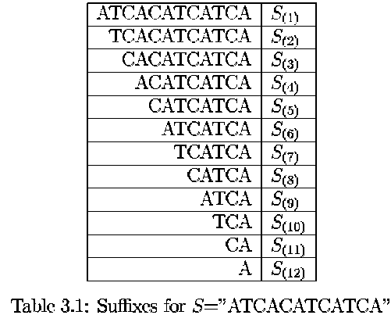
Suffix Trees and Suffix Arrays

Slide 49
The Suffix
S = ATCACATCATCA
  The substrings which start with A.
  The substrings which start with C.
  The substrings which start with T.
Any substrings which starts with A must be one of the following suffixes: S(1), S(4), S(6), S(9) and S(12)

Slide 50
The Suffix Tree
Each tree edge is labeled by a substring of S.
Each internal node has at least 2 children.
Each S_{(i)} has its corresponding labeled path from root to a leaf, for 1< i < n .
There are n leaves.
No Edges branching out from the same internal node can start with the same character.

Slide 51
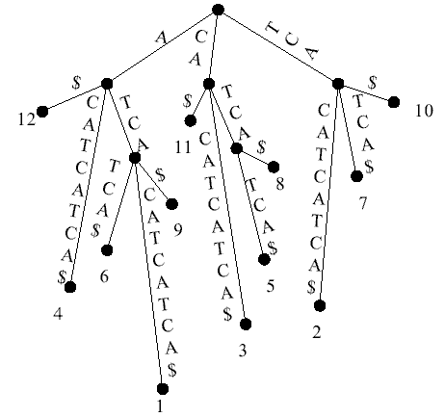
A suffix Tree for S=“ATCACATCATCA”

Slide 52
Finding any substring easily in S with the Suffix Tree
S = “ATCACATCATCA”
P =“TCAT”
  P is at position 7 in S.
P =“TCA
  P is at position 2, 7 and 10 in S.
P =“TCATT”
  P is not in S.

Slide 53
Creating A Suffix Tree
Divide all suffixes into distinct groups according to their starting characters and create a node.
For each group, if it contains only one suffix create a leaf node and a branch with this suffix as its label; otherwise, select a suffix with the longest common prefix among all suffixes of the group and create a branch out of the node with this longest common prefix as its label. Delete this prefix from all suffixes of the group.
Repeat the above procedure for each node which is not terminated.

Slide 54
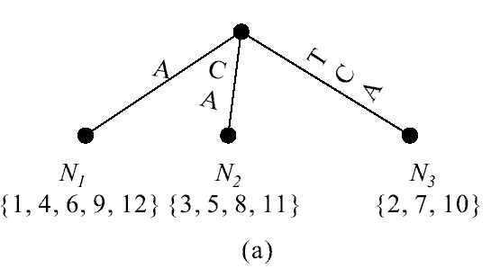
Creating A Suffix Tree(2)
Take N₃ as instance.
S(2) =“TCACATCATCA”
S(7) =“TCATCA”
S(10) =“TCA”

Slide 55
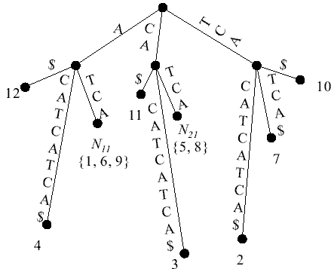
Creating A Suffix Tree(3)

Slide 56
A suffix tree for a text string T of length n can be constructed in O(n) time.
To search a pattern P of length m on a suffix tree needs O(m) comparisons.
Thus we have an O(n+m) time algorithm for the exact string matching problem.

Slide 57
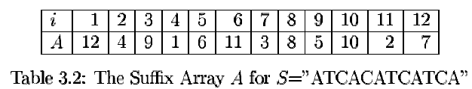
The Suffix Array
An array A of n elements is called the suffix array for S if strings S_{(A[1])}, S_{(A[2])}, …, S_{(A[n])} are in the non-decreasing lexical order.
For example, the non-decreasing lexical order of suffices of S=“ATCACATCATCA” is S₍₁₂₎, S₍₄₎, S₍₉₎, S₍₁₎, S₍₆₎, S₍₁₁₎, S₍₃₎, S₍₈₎, S₍₅₎, S₍₁₀₎ and S_{(7).}

Slide 58
If T is represented by a suffix array, it takes O(mlogn) time time to find P in T because a binary search can be conducted on the array.
A suffix array can be determined in O(n) by lexical depth first searching in a suffix tree for a string of length n.
The total time will be O(n+mlogn) time.

Slide 59
Approximate String Matching
Given a text string T of length n, a pattern string P of length m and a maximal number of errors allowed k, the approximate string matching is to find all text positions where the pattern matches the text up to k errors, where errors can be substituting, deleting, or inserting a character.
For instance, if T =“pttapa’, P =“patt” and k =2, the substrings T_{1,2} ,T_{1,3} ,T_{1,4} and T_{5,6} are all up to 2 errors with P.

Slide 60
The Suffix Edit Distance
Two strings S₁ and S₂.
The suffix edit distance which is the minimum number of substitutions, insertion and deletions, which will transform some suffix of S1 into S2.
  Consider S1=“p” and S2=“p”. The suffix edit distance between S1 and S2 is 0.
  Consider S1=“ptt” and S2=“p”. The suffix edit distance between S1 and S2 is 1.

Slide 61
What is the meaning of the suffix edit distance between T and P?
If it is not greater than K, then we know that there is an approximate matching of a suffix of T with P with error not greater than k. That is, we have succeeded in finding a desired approximate matching.

Slide 62
Let us consider T =“pttapa”, P =“patt” and K=2
  For T_{1,1}=“p” and P =“patt”, the suffix edit distance is 3.
  For T_{1,2} =“pt” and p =“patt”, the suffix edit distance is 2.
  For T_{1,5} =“pttap” and p =“patt”, the suffix edit distance is 3.
  For T_{1,6} =“pttapa” and p =“patt”, the suffix edit distance is 2.

Slide 63
Approximate String Matching(2)
The approximate string matching problem now becomes a problem of the following problem: Given T and P, find the suffix string edit distances between T_{1,i} and P for i =1, 2, …, n where n is the length of T.
This problem can be solved by using the dynamic programming approach.

Slide 64
Dynamic programming :
Let E(i,j) denote the suffix edit distance between T_{1,j} and P_{1,i}.
For T_{1,j} and P_{1,i}, to find the suffix edit distance :
  Case 1. T_{j} =P_{i}. In this case, we find E(i-1, j-1). Set E(i, j) = E(i-1,j-1).
  Case 2. T_{j} >< P_{i}. In this case, we find E(i, j-1) and E(i-1, j). Set E(i, j) = min{ E(i, j-1), E(i-1, j)}+1

Slide 65
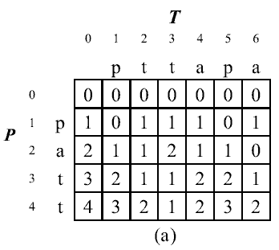

Slide 66
